Slide 1
IMMOBILIZATION (FIXATION)
Mohammed Majid Jasim

Slide 2
Immobilization
Immobilization involves fixing the bone fragments, they are motionless with respect to each other during the healing process.
The objectives are:
1- To stabilize the fragments.
2- To prevent displacement, angulation, and rotation.

Slide 3
Immobilization
Methods of Fixation:
The methods of fixation may be classified as follows:
1. Limb splintage (coaptation splints, casts, modified Thomas splint)
2. Bone splintage (intramedullary pin, external skeletal fixator, bone plate)
3. Compression (lag screw, cerclage/interfragmentary wire, tension band wire,
tension band/compression plate)

Slide 4
Types of casts
Long-Leg Cylinder Cast:
A long-leg cast is one that extends from the toes to the axilla or groin. Plaster of Paris or fiberglass/resin tape are the most commonly used materials.
Indications:
Immobilization of the elbow and stifle, the radius and ulna, and the tibia and fibula.

Slide 5
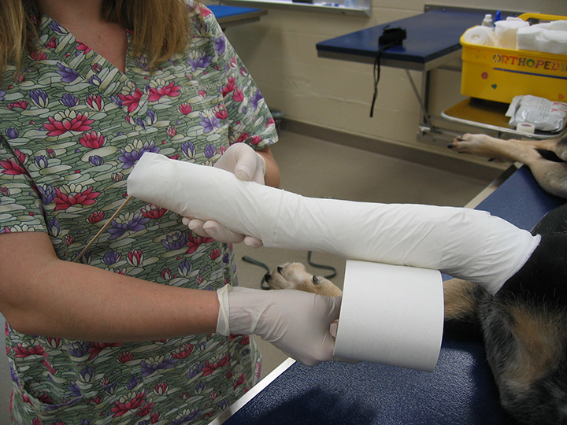
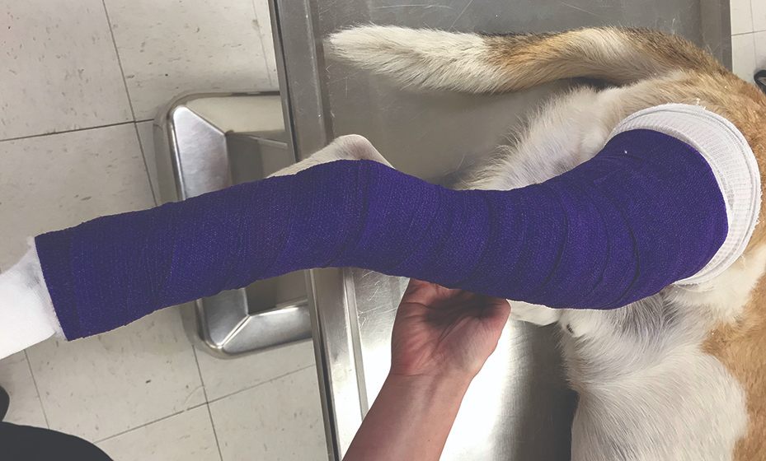

Slide 6
Types of casts
Short-Leg Cylinder Cast:
A short-leg cast extends only to the proximal tibia or radius . The elbow and stifle joints are free to move normally. The casts must be distal enough (1-2 inches below the humeral epicondyle or tibial tubercle) so that there is no binding during flexion/extension. Limb swelling under a cast may lead to bad sequelae.
Indications:
Immobilization of the carpus and metacarpus and the tarsus and metatarsus. As a general rule, short-leg casts are used primarily in large, active animals to provide more stabilization.

Slide 7
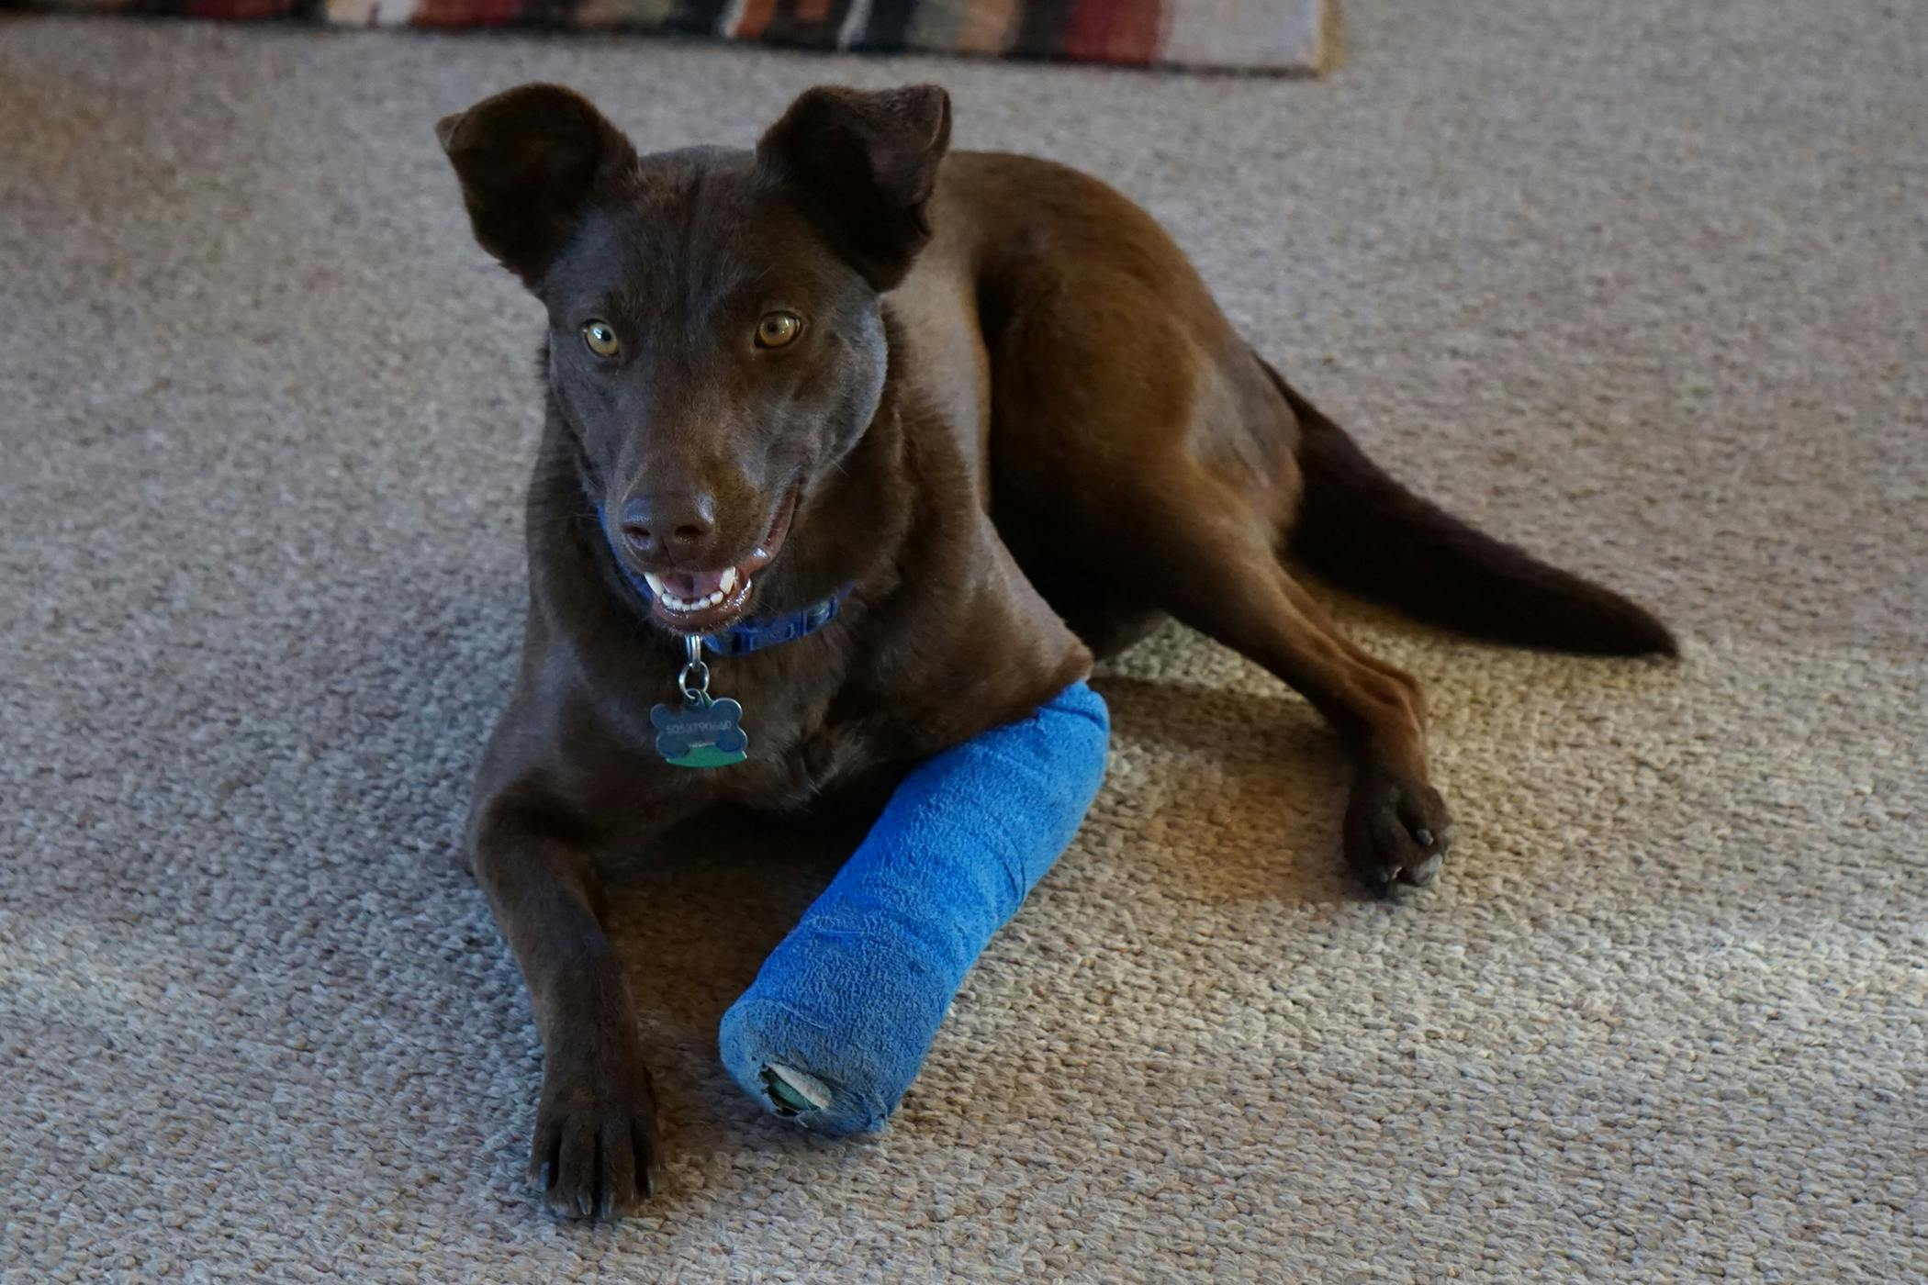
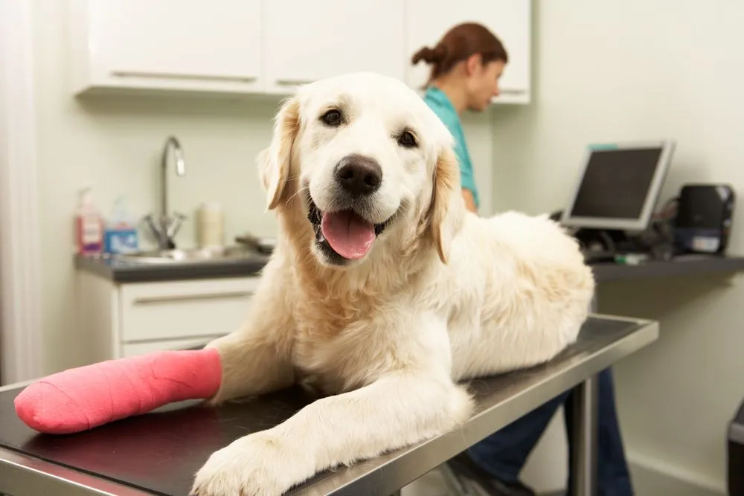

Slide 8
Types of casts
Spica Splint - Foreleg:
Although this splint can be constructed with wood, rigid plastics, or aluminum, the molded splint is better tolerated and gives better immobilization . The spica splint is named for the method of attaching it to the body by a “spica” (figure-of-8) bandage. In the dog the bandage is modified to be only half a figure of- 8. It can be applied to the hip, but bandaging in this region is very difficult, especially in the male dog, and ambulation is awkward.
Indications:
Immobilization of the shoulder, humerus, and elbow.

Slide 9
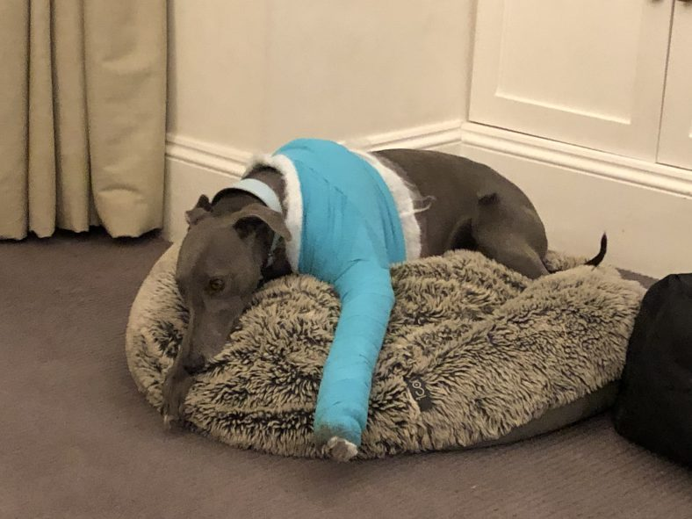
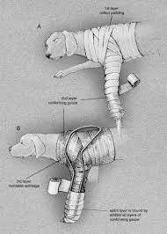
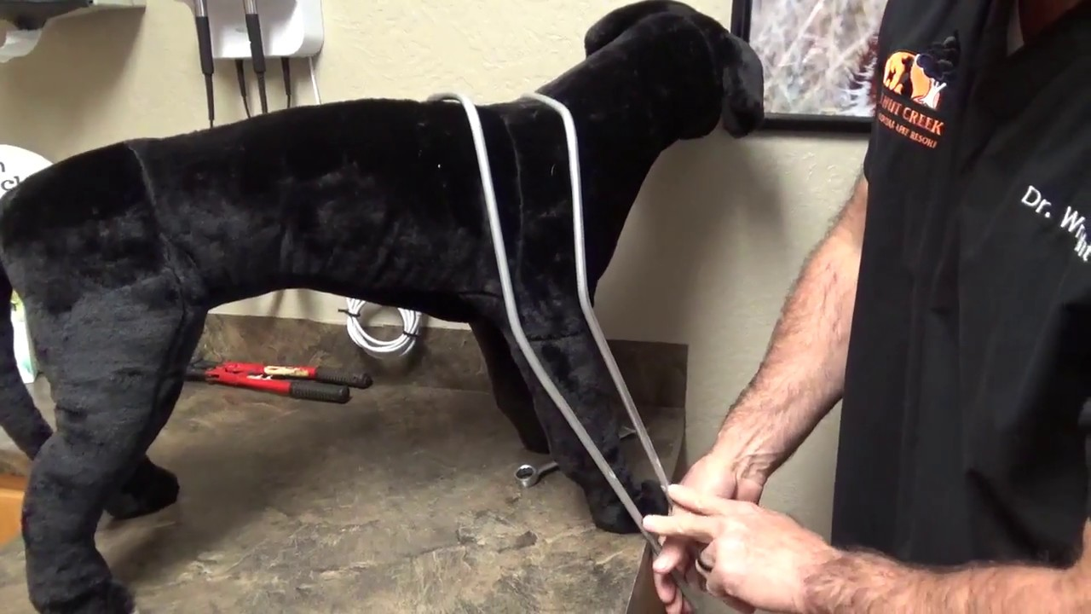

Slide 10
Types of casts
Long Lateral Splint:
This splint is shorter than a spica splint, but otherwise the long lateral splint is constructed and attached similarly from the axilla or groin distally.
Indications:
Immobilization of the elbow and stifle joints.

Slide 11
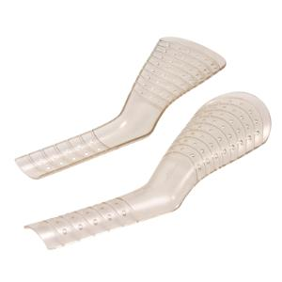
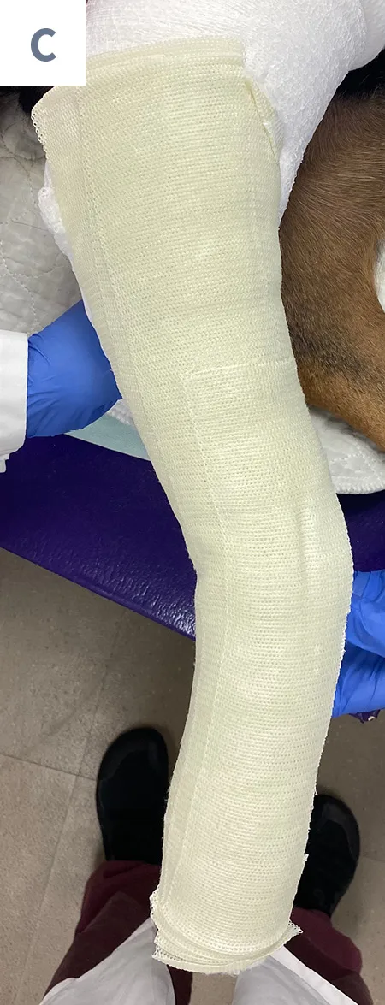
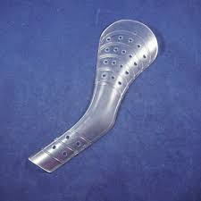

Slide 12
Types of casts
Schroeder-Thomas Splint:
This versatile splint has been widely used for immobilization of fractures. Considerable artistry is required to construct a functional, well tolerated, and effective Schroeder-Thomas splint. Widely used in the past, it has been largely superseded by molded splints and casts.
Indications:
Immobilization of the elbow, stifle, carpus, and tarsus; the radius and ulna; and the tibia and fibula. The Schroeder-Thomas splint may be the most effective device for immobilization of the stifle joint at a functional angle. Care must be taken to keep the splint as short as possible to allow active weight bearing.

Slide 13
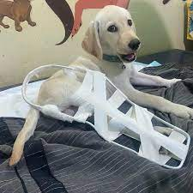
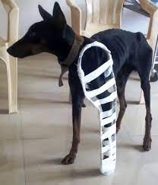
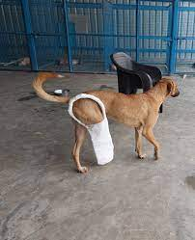

Slide 14
Types of casts
Short Lateral Splint - Hindleg:
Although this type of molded splint can be applied to any surface of the lower hindlimb, the lateral surface has resulted in fewer soft tissue injuries.
Indications:
Immobilization of the tarsus and metatarsus.

Slide 15
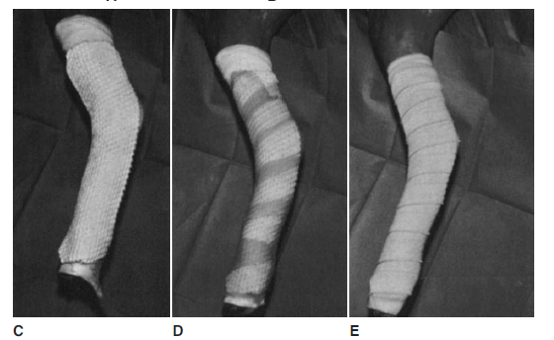

Slide 16
Types of casts
Short Caudal Splint - Foreleg:
This splint replaces the preformed rigid plastic and metal “spoon” splints in wide use. Such splints are not suitable for long-term use because of the incidence of soft tissue problems and poor immobilization. The only way a curved limb can be put in a straight pre molded splint is with copious padding, and this destroys rigid immobilization. A properly made molded splint can often be left on for 6 weeks with no soft tissue problems.
Indications:
Immobilization of the carpus and metacarpus.

Slide 18
Types of casts
Phalangeal Splint:
This bivalved splint is designed to protect the toes while leaving the antebrachiocarpal or tarsocrural joints free to move normally.

Slide 20
Types of casts
Velpeau Sling:
This bandage is generally well tolerated by most animals. In addition to its main use for shoulder and scapular injuries, the Velpeau sling can serve as a substitute for hard casts or splints when the objective is simply to prevent weight bearing of the foreleg.

Slide 21
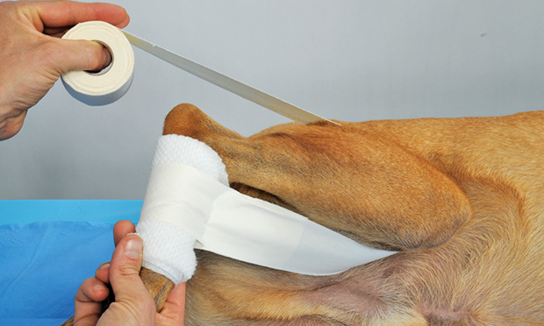
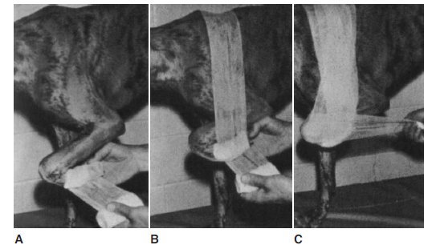
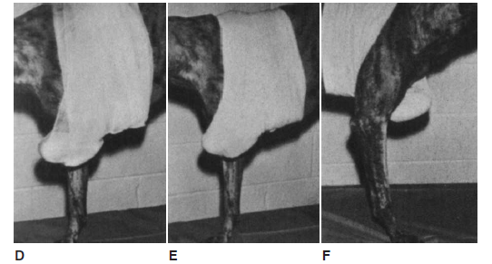

Slide 22
Types of casts
Ehmer Sling:
Primarily used to partially immobilize and stabilize the hip joint , this bandage can also be used to prevent weight bearing of any joint of the hindlimb.

Slide 24
Types of casts
ASPCA Sling:
This sling is very effective in preventing weight bearing on the hindlimb while still allowing passive motion of the hip and stifle joints. The ASPCA sling is better tolerated and has fewer complications than the Ehmer sling.

Slide 26
Types of casts
Robert-Jones Bandage:
This highly padded bandage is very versatile, being useful not only in immobilization distal to the elbow or stifle but also in decreasing or preventing edema . It is well tolerated, but because of the large volume of cotton, it can absorb considerable quantities of water and cause maceration of skin or contamination of surgical incisions. The Robert-Jones bandage is generally used only for short-term immobilization.

Slide 28
INTRAMEDULLARY PINS
Intramedullary (IM) pin (or nail) fixation for fracture treatment in small animals started in the 1940s. It slowly gained popularity largely through the advent of safe general anesthesia, aseptic technique, antibiotics, and awareness by veterinarians and clients alike that successful repair could be accomplished in the majority of cases. Despite its limitations, IM pinning remains as the most common form of internal fixation worldwide in veterinary orthopedic surgery.

Slide 29
INTRAMEDULLARY PINS
Advantages of Intramedullary Fixation:
There are many potential advantages of pin and wire fixation over bone plates for the veterinary surgeon.
1-Pin and wire fixation is much less expensive than bone plate fixation when the cost of implants, the large inventory of equipment needed, maintenance, and repair costs for bone plating equipment are compared to pinning costs.
2-Most pin and wire fixations require less surgical exposure than for bone plates, resulting in less tissue trauma and vascular damage and enhanced healing.
3-In general, pins and wires can be applied in less time than needed for plates; this factor saves money and decreases anesthesia time.

Slide 30
INTRAMEDULLARY PINS
Disadvantages of Intramedullary Fixation:
Pins and wires definitely have disadvantages compared with plates:
1-If bone fragments are too small to be reduced and stabilized, pin and wire fixation may not be as stable as a plate.
2-Pin and wire fixation is not designed to maintain bone length (act as a support), since there is no load sharing between the round pin and the bone.
3-Plates, do have the ability to prevent compressive forces from causing collapse (shortening) of a multifragment fracture.

Slide 31
INTRAMEDULLARY PINS
Pin Types:
1- Steinmann Pins and Kirschner Wires:
Both Steinmann pins and Kirschner wires (K-wires; pins that look like Steinmann pins but are smaller in diameter: 0.035, 0.045, and 0.062 inch, or 0.9 to 1.5 mm) are circular in cross section and either smooth or with partial or fully negative thread- profile shanks . Steinmann pin diameters vary from 1/16 inch (1.5 mm) to 1/4 inch (6.5 mm).

Slide 32
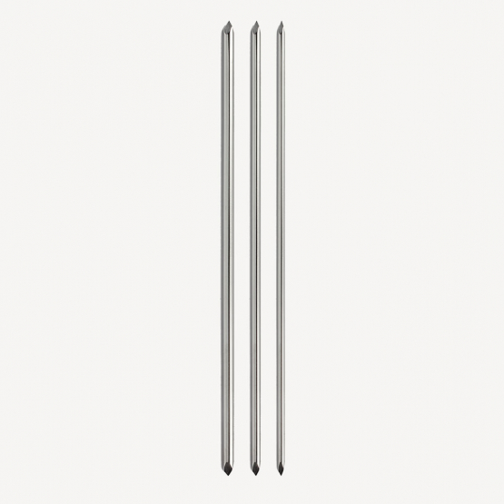

Slide 33
INTRAMEDULLARY PINS
2-Rush Pins:
Rush pins are dynamic intramedullary splints, exerting continuous compression forces at two or three points on the bone because they become flexed during introduction. This flexion is induced by introducing the pin at an angle of about 20 degrees to the axial axis of the bone, rather than on the axial axis as with the Steinmann pin. the Rush pin has a noncutting beveled point that glides rather than cuts when it encounters bone.
The opposite end is hook shaped to allow:
close approximation of this end with the bone.
Positive control of the direction of the flexion during introduction.

Slide 34
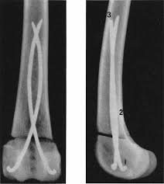
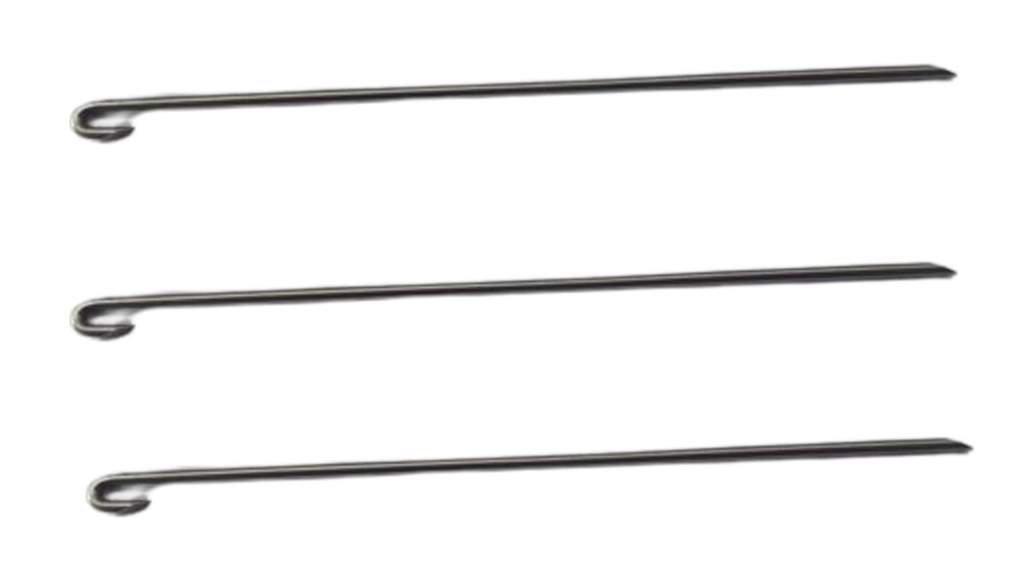

Slide 35
INTRAMEDULLARY PINS
3-Küntscher Nail:
Although it was one of the early forms of intramedullary fixation in the dog because of its wide use in human patients at the time, the Küntscher nail has never achieved wide application in small animals. The V cross-sectional shape requires close contact of the pin through a considerable length of the bone to ensure stability. Because dog bones rarely are true cylinders, and because the cortex is too thin for reaming to a uniform diameter as is done in human bone, this device is not very useful in dogs or cats.

Slide 36
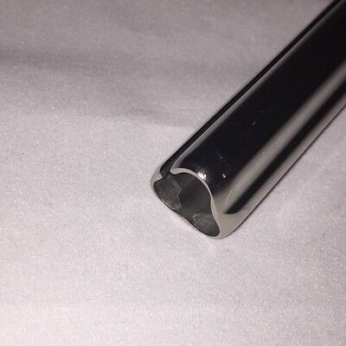

Slide 37
INTRAMEDULLARY PINS
4-Interlocking Nail:
An interlocking nail is basically an IM pin secured in position by proximal and distal transfixing screws that secure the bone to the nail to provide torsional and axial stability. The use of the interlocking nail has considerable advantages over the use of IM pins alone. The interlocking nail helps to prevent collapse of comminuted fractures during weight bearing, rotational instability, and pin migration. As with the IM pin, the interlocking nail can be inserted through a limited surgical approach, with minimal disruption of fragment blood supply.

Slide 39
Indications for Intramedullary Fixation
Steinmann Pin
Steinmann pin fixation are limited to the following:
1. Stable fractures that do not have a tendency for axial shortening or rotation.
2. In skeletally immature animals, especially puppies and kittens less than 4 months of age, fractures can be successfully treated because of the rapid callus formation seen in these animals.

Slide 40
Indications for Intramedullary Fixation
Rush Pin:
The use of Rush pins for diaphyseal fractures in dogs and cats has not been well evaluated. The primary application for these pins is in proximal or distal fractures, where the double-pin configuration provides good stability. When there is an intraarticular component, the Rush pin is easily combined with lag screw fixation.
Interlocking Nail:
All diaphyseal fracture types in the humerus, femur, and tibia are amenable to fixation using interlocking nails as long as the medullary canal diameter is at least 4 mm.

Slide 41
CERCLAGE WIRE:
The term cerclage means “to encircle” or “to wrap into a bundle.” This procedure refers to a flexible wire that completely or partially passes around the circumference of a bone and is then tightened to provide static interfragmentary compression of bone fragments.
Indications:
Cerclage wires are used primarily on long oblique, spiral, and certain comminuted or multiple fractures. They are used as ancillary fixation with IM pins, external skeletal fixators, and bone plates. Additionally, cerclage wires are used intraoperatively to aid in holding fracture segments in the reduced position while primary fixation is applied

Slide 42
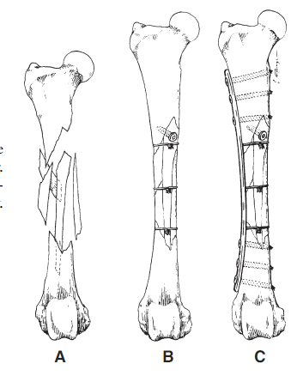

Slide 43
BONE SCREWS:
There are two basic types of bone screws:
1-cancellous screws.
2-cortical screws.
Bone screws are usually employed to provide static interfragmentary or plate/bone compression by means of the lag screw principle. A secondary function of bone screws is to hold fragments in a fixed position without interfragmentary compression, where it is called a position screw.

Slide 44
